Slide 1
Effective Study Notes

Slide 2


Slide 3
Wouldn’t it be great if you had a photographic memory like Miss Ross from the TV series Suits?
Unfortunately most of us do not have that luxury. Instead, students need a way of storing important content that can be processed, reviewed and memorised in preparation for exams and tests.

Slide 4
Effective Study Notes are the foundation of most top ranking students.
In this unit, you will be introduced to a variety of methods that top ranking students have used over the years.
There is no single method which creates the best study notes. Everyone is different and the best notes are the notes which suit you and the way that you learn and process information.
HAVE YOU EVER BEEN TAUGHT HOW TO TAKE PROPER STUDY NOTES?

Slide 5
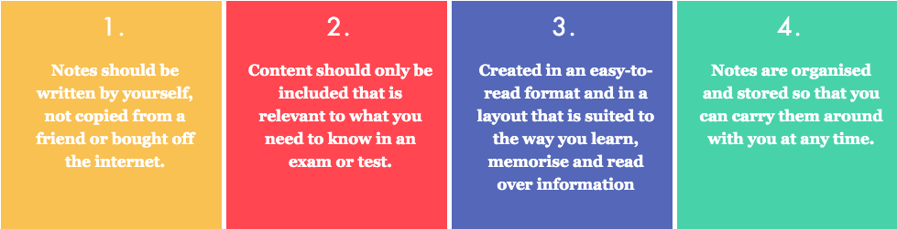
What are Effective Study Notes?
Study notes are basically a condensed version of all the information you have learnt in class from your teacher or from other sources such as your textbook. Effective study notes will be different for each individual student, however they should follow the following four criteria.

Slide 6
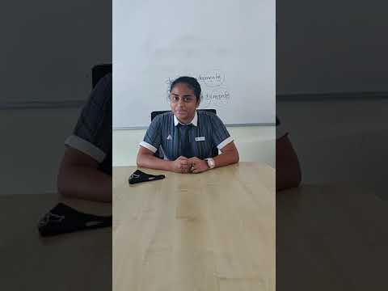
Wait, Do I Even Need To Create Study Notes?

Slide 7
Effective study notes, although at first will take some time to prepare, will in the long run save you time and make you less anxious when revising for your exams.
And besides, WAKE UP, getting good grades is hard work, things are not supposed to be easy and handed to you on a silver platter. If that was the case, everyone would get good grades.

Slide 8


Slide 9
Good study notes are not necessarily about how neat your handwriting is.
More so they should have good structure, organisation and content. If your handwriting is unreadable there are other tools to format notes. More on this soon.

Slide 10


Slide 11
Note-taking is a skill. For some students it takes several years to get right. Alot of experimentation and trying new formats is needed. Yes, it is more important for Year 12 students to help with their final exams, but mastering note-taking in Year 7,8 and 9 will give you an edge when you get to upper school. Start early.

Slide 12


Slide 13
This is not what the top students do. Creating proper notes is an integral part of understanding class material and preparing for exams/tests.
Effective notes can save you time and confusion in the long run, that often results from being disorganised or relying on a wordy textbook.

Slide 14


Slide 15
Studies have shown that student’s learn while they take their notes. The act of creating your notes helps make connections with information and helps memorise this information.
You might not be learning as you are writing, but subconsciously, alot of information will be sinking in.
Moreover, when you create your own notes, you are doing them in a way that you understand.

Slide 16
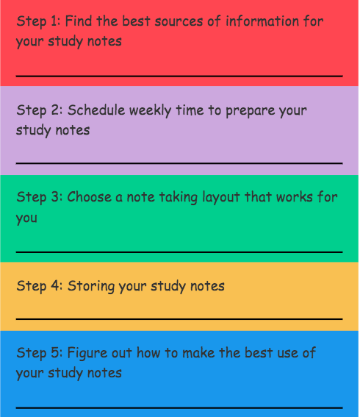
5 STEP PLAN TO MAKING EFFECTIVE STUDY NOTES THAT WORK FOR YOU

Slide 17
Step 1: Find the best sources of information for your study notes
When you narrow it down, there are basically 5 key categories of sources.
THE SYLLABUS
THE SUBJECT TEXTBOOK
THE TEACHER
STUDY GUIDES
THE INTERNET

Slide 18
THE SYLLABUS
The syllabus is usually a big boring document with lots of unnecessary information, but if you search properly, it will:
provide a scaffold and order for your notes.
It will outline all topics and essential information you will need to learn for an assessment or exam.
You can only be examined on what is in the syllabus.

Slide 19
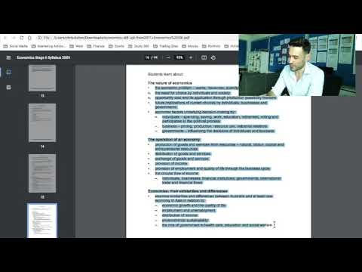

Slide 20
2. THE SUBJECT TEXTBOOK
The textbook is usually the main go-to source for most students when preparing study notes..
However, many students tend to struggle taking proper notes from a textbook.
Some suggestions of using the textbook for study notes include:
Make sure you are reading and taking notes from the correct section of the textbook.
Do not write everything from the textbook. You do not need all the content from the textbook. Break it up into smaller parts, dot point key points and only include relevant information.
Try and not copy word for word from the textbook, especially if you don’t understand the content. Paraphrase information.
Most textbooks will make it obvious on what is the most important information. Find the cues. The subheadings are obviously the key sections of the chapter. Most textbooks also highlight key definitions that you need to know and some have a summary section at the end of the chapter.

Slide 21
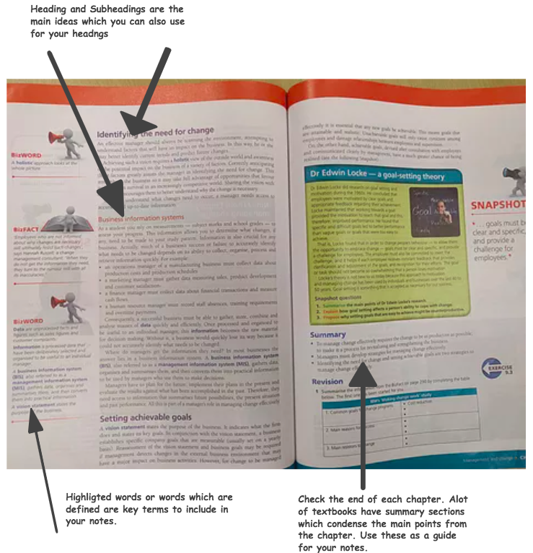

Slide 22

3. THE TEACHER
Not sure what to include in your study notes? Look to the person who is responsible for creating your tests and preparing you for your exams, your teacher.
Some teachers will design PowerPoints, study guides and extra resources to guide you in the right direction. Usually these resources are a hint to what will be in your tests and exams.
Also listen out to repeated information. If your teacher keeps going over the same thing it is obviously important. If you are unsure, then ask.

Slide 23

4. STUDY GUIDES
Study guides or revision guides are a resource that covers all sections of a subject but in far less words than a regular textbook. They omit all the unnecessary information and only cover content which is examinable. They also include tips, insights and practice questions. Students love these guides because they save time and make life easier when creating your own study notes.

Slide 24

5. THE INTERNET
If you are still not satisfied with what your teacher has provided, the textbook or the revision guides then there is always the big wide world of the internet. Whether it be webpages, news articles, social media, YouTube or forums, there is an extraordinary amount of information available online.
Some past students actually sell their study notes online or you can even download some for free. Although I recommend only using these as a guide they are good resource to get you started in the right direction. Some example of sites which offer study notes include:
Thinkswap
ATAR Notes
Ace HSC
StudyCollab IBDP Revision Notes
Nail IB
Study Nova for the IB

Slide 25
Step 2: Schedule weekly time to prepare your study notes
The golden rule of effective study notes:
DO NOT LEAVE YOUR STUDY NOTES TO THE LAST MINUTE
Effective study notes should not be rushed and need to be regularly reviewed. Learning takes time. Turning information into memory doesn’t happen overnight, you need constant exposure to your study notes over a spaced out period. Waiting until the last minute is not effective.
This means that notes need to be done on a regular basis. The best approach would be to allocate time once a week or fortnight to catch up on study notes for every subject.
The reality is that most students do not do this. Some wait until just before a test or exam. Top students make the time to do study notes regularly. Organisation is the key.

Slide 26


Slide 27
Step 3: Choose a note taking layout and method that works for you
Every student is different. How you prefer to create and read notes is different to the next student.
There is no correct way. The correct way is the way that responds to you.

Slide 28
Digital Notes v Handwritten Notes
One of the first questions students ask is
“should I use my laptop/computer to create notes or stick to good old fashioned handwriting?”

Slide 29


Slide 30
Suggestions:
If your handwriting is really messy go the digital approach. Messy notes can destroy the motivation to review them.
If you are a very good touch typer or a “techy” student, take full advantage of that and go the digital approach to make full use of some of the cool applications out there today.
If you are creative or do i dare say you actually enjoy creating notes, go the old fashioned approach, it can be very satisfying, even rewarding making fantastic looking notes.

Slide 31
The Layout
Lets look at an example of some sources and different layouts well organised students have used in the past for their note taking.
The sources are derived from the Year 12 HSC Economic Course in NSW. The section of the course deals with “Types of Unemployment”.

Slide 32
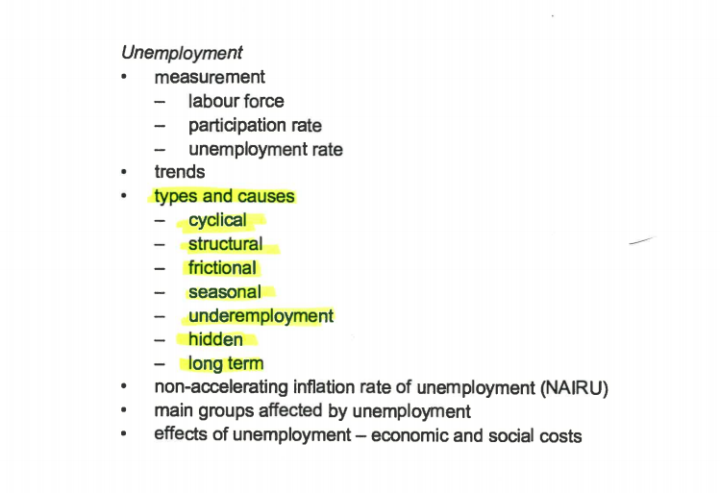
Source Number 1
It is clear that “Types of Unemployment” is in the syllabus. This indicates that it is examinable and must be included in your notes. The order for these notes should replicate the syllabus
Heading: Types of Unemployment
Sub Headings: Cyclical, Structural, Frictional etc

Slide 33
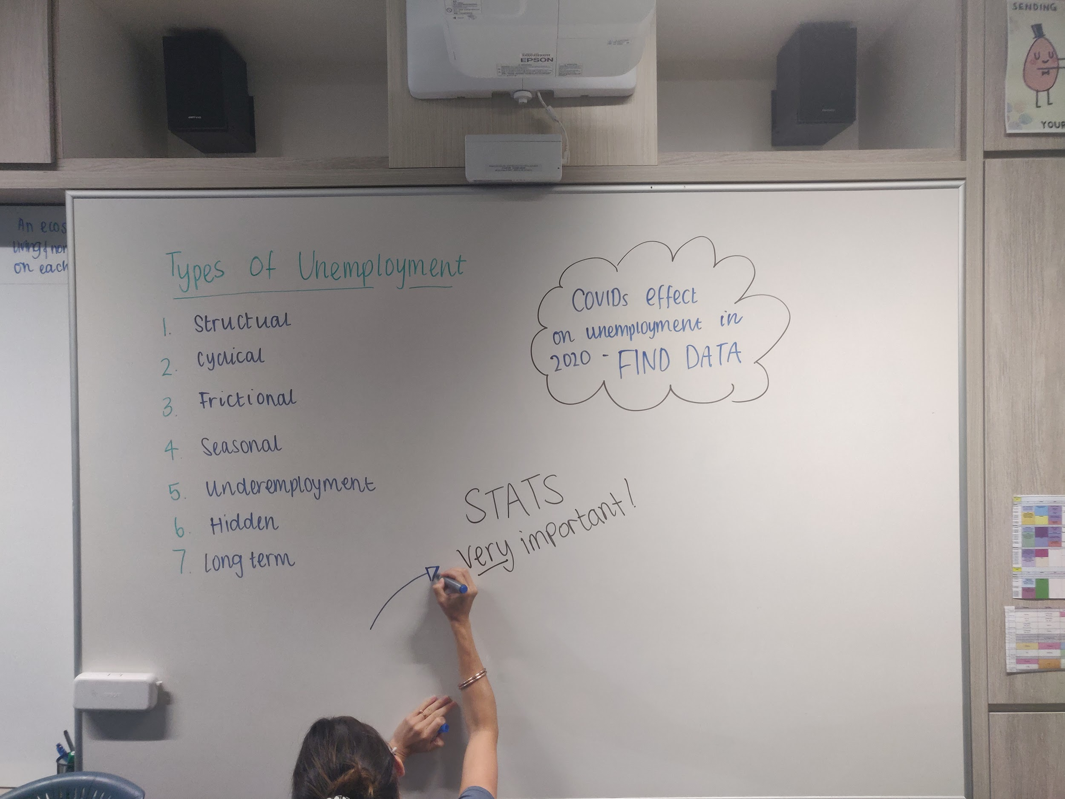
Source Number 2
Looking at the white board the teacher has hinted that real life stats of unemployment particularly from the 2020 COVID period are important to know. This should be included in the notes (using the internet to help find the data).

Slide 34
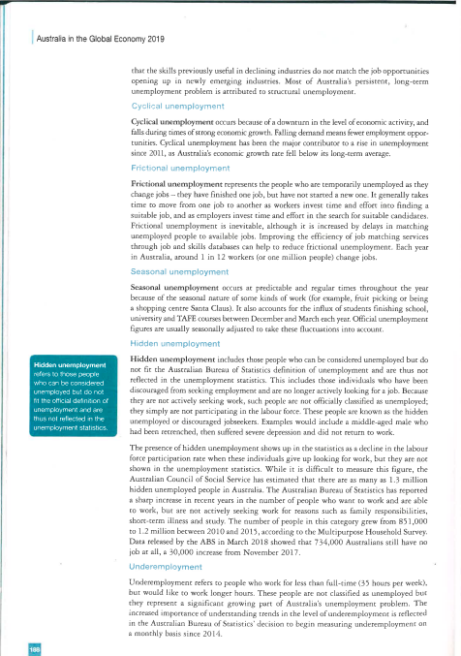
Source Number 3
The textbook has the key information for the types of unemployment, but looks chunky. This can be trimmed down, with only the key points included in your notes. Remember to keep it simple, including key definitions and even putting it into your own words to help with understanding and memorising later on.

Slide 35
Ok, so now that all the information is available, you can start to design your notes.
Note taking styles can vary, but the top students all have one thing in common when it comes to their notes - they are well structured and organised. Lets take a look at some common approaches taken by top students.

Slide 36
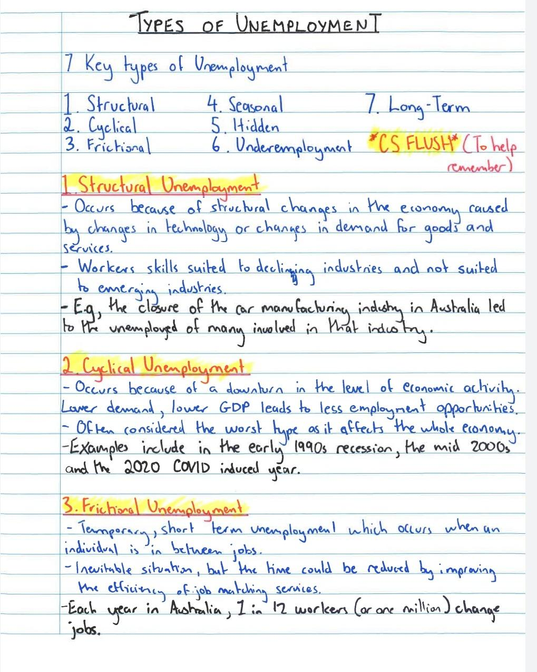
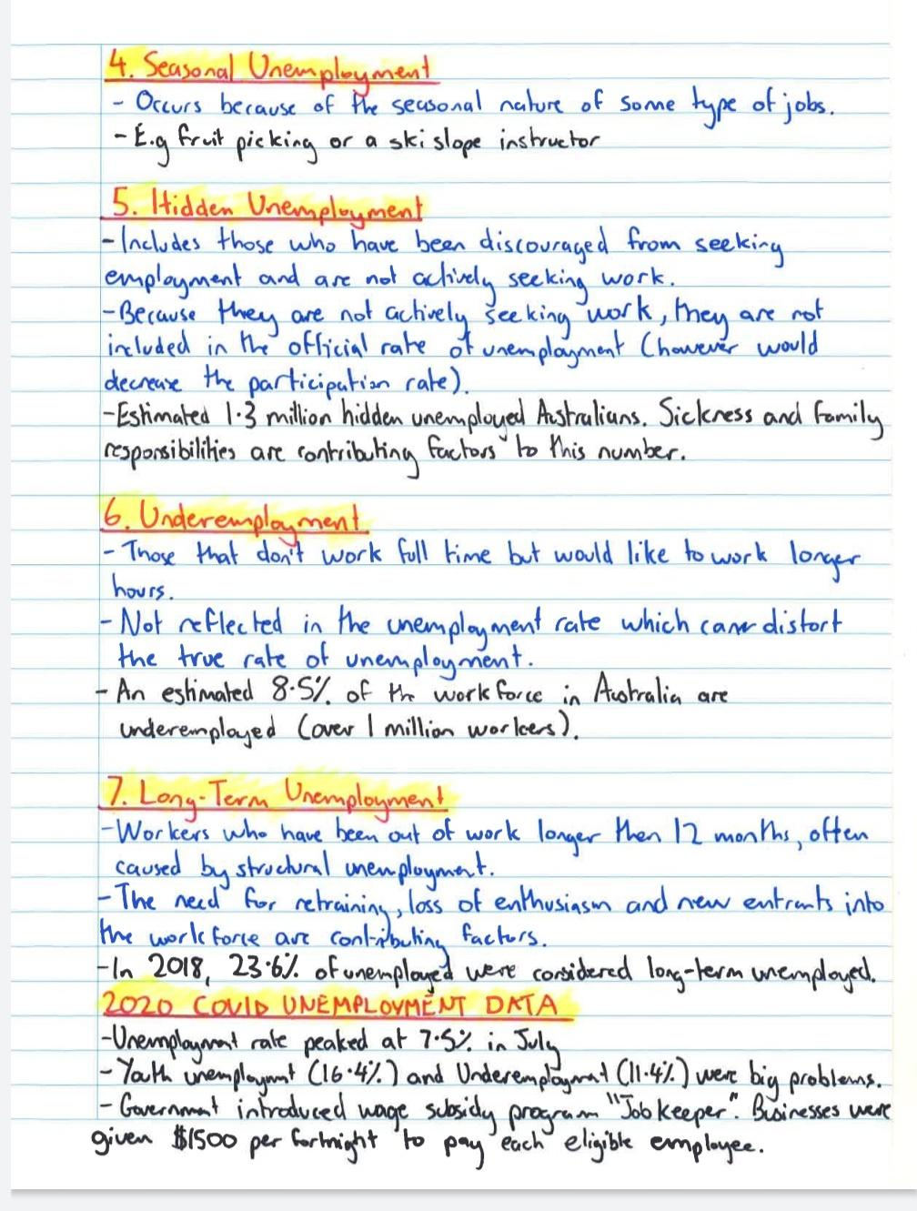
The “No Frills” Student (Handwritten)

Slide 37
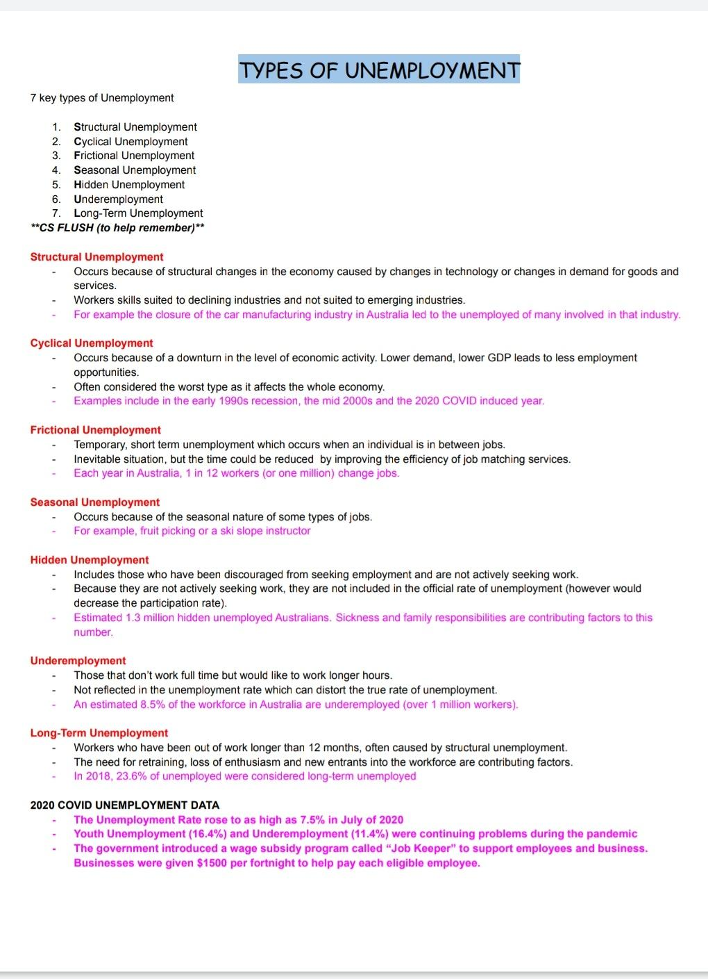
2. The “No Frills” Student (Digital)

Slide 38
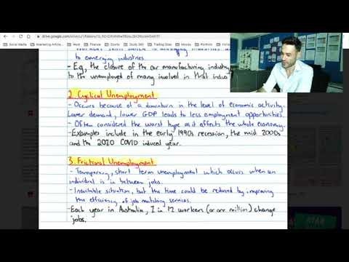

Slide 39
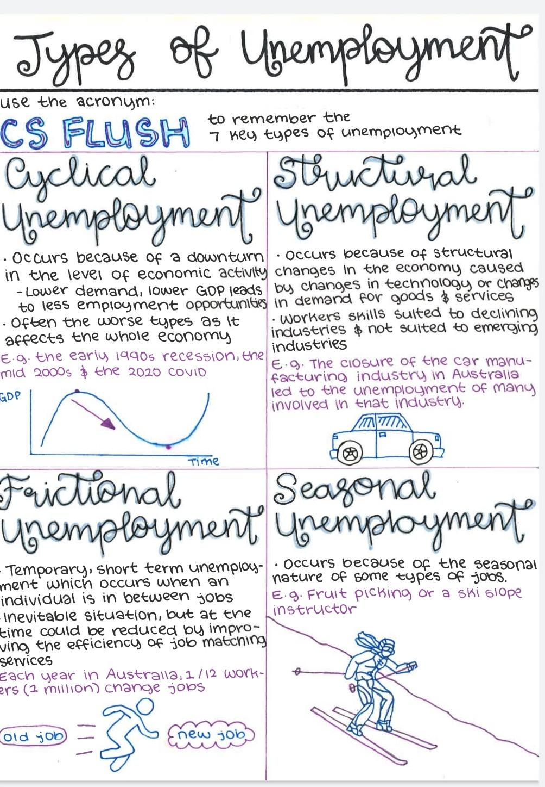
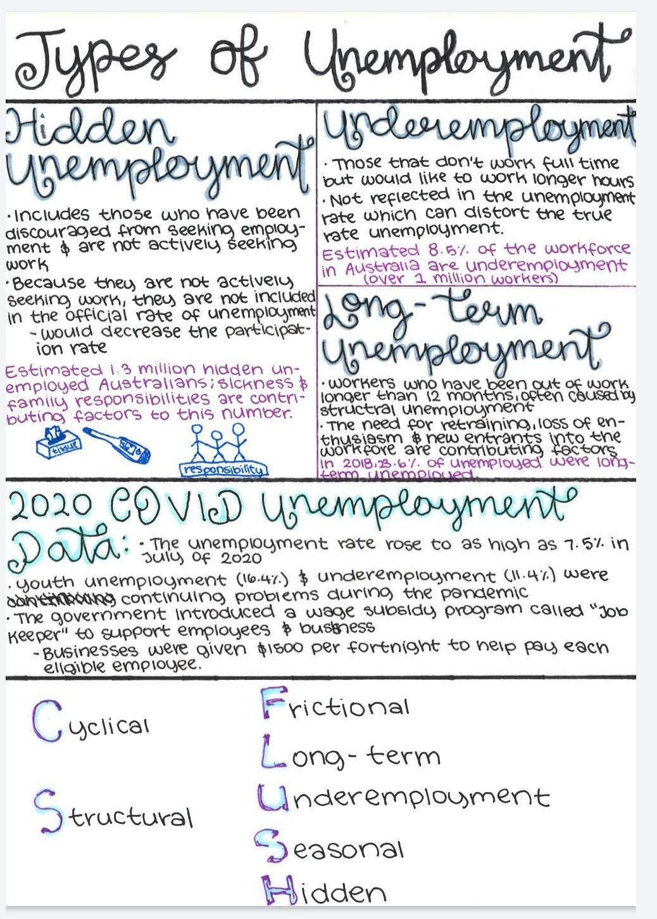
3. The Visual/Creative Student (Handwritten)

Slide 40
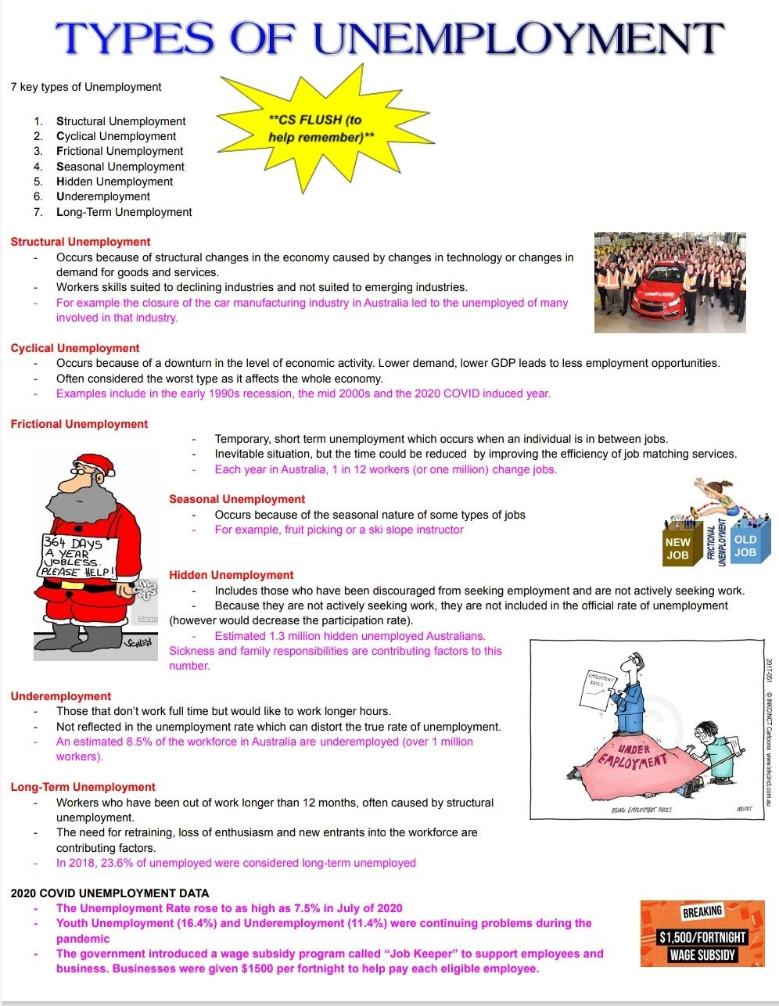
4. The Visual/Creative Student (Digital)

Slide 41
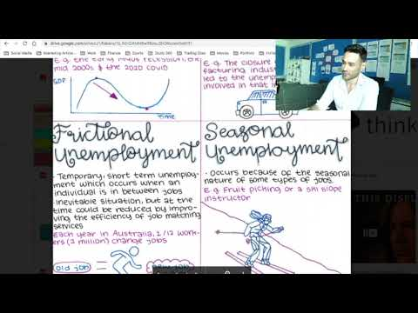

Slide 42
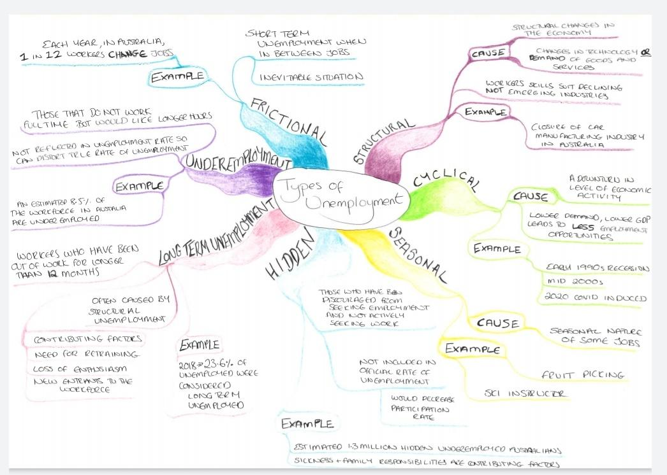
5. The Mindmapping Student

Slide 43
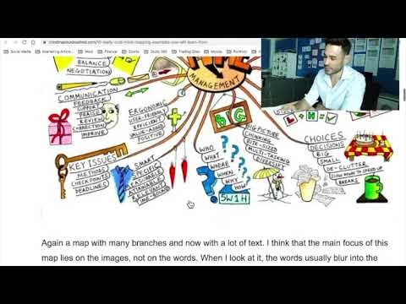

Slide 44
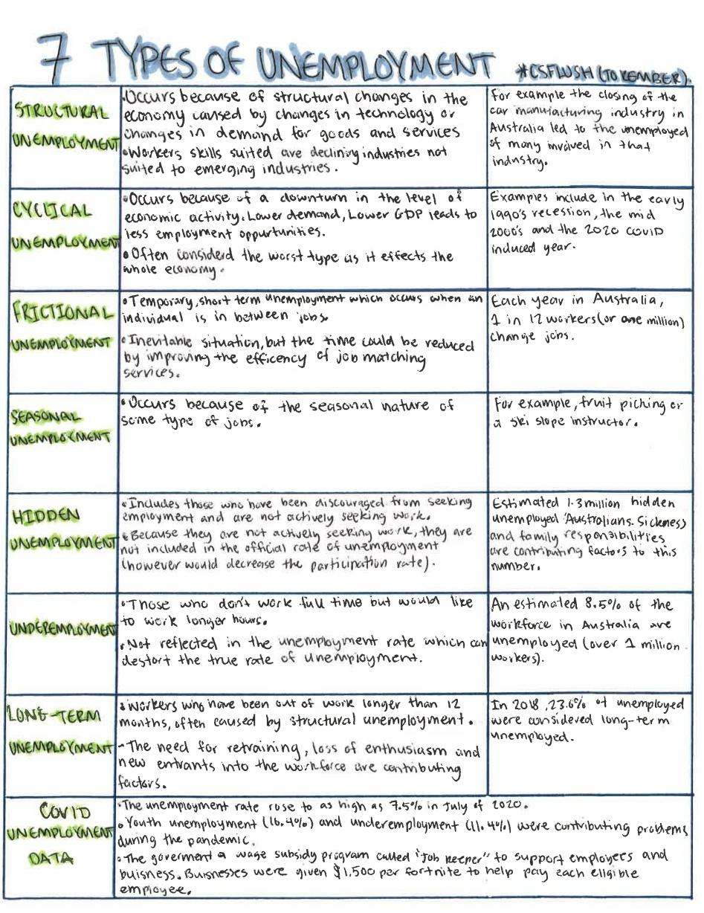
6. The “I Love Tables” Student (Handwritten)

Slide 45
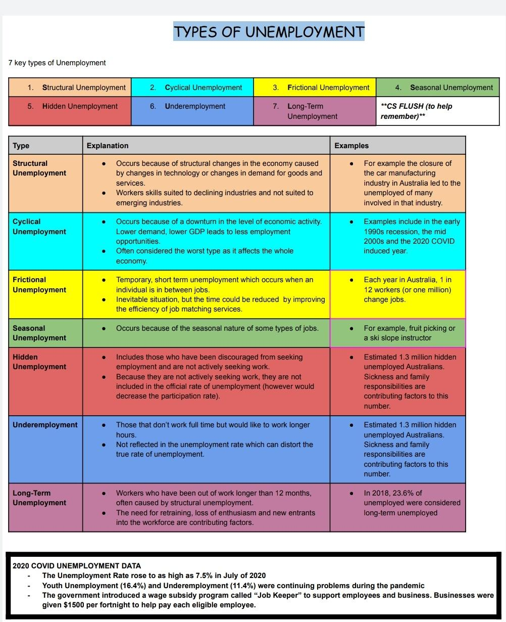
7. The “I Love Tables” Student (Digital)

Slide 46
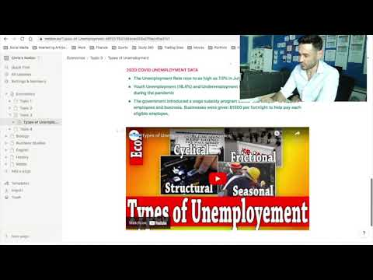
8. The App Student

Slide 47
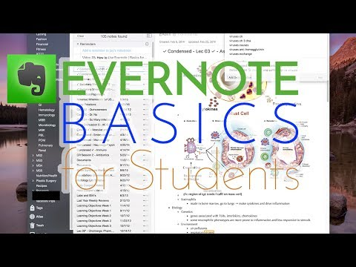

EVERNOTE

Slide 48
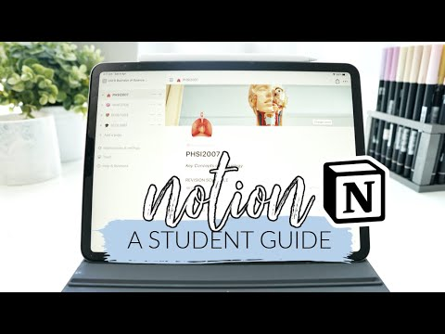

NOTION

Slide 49
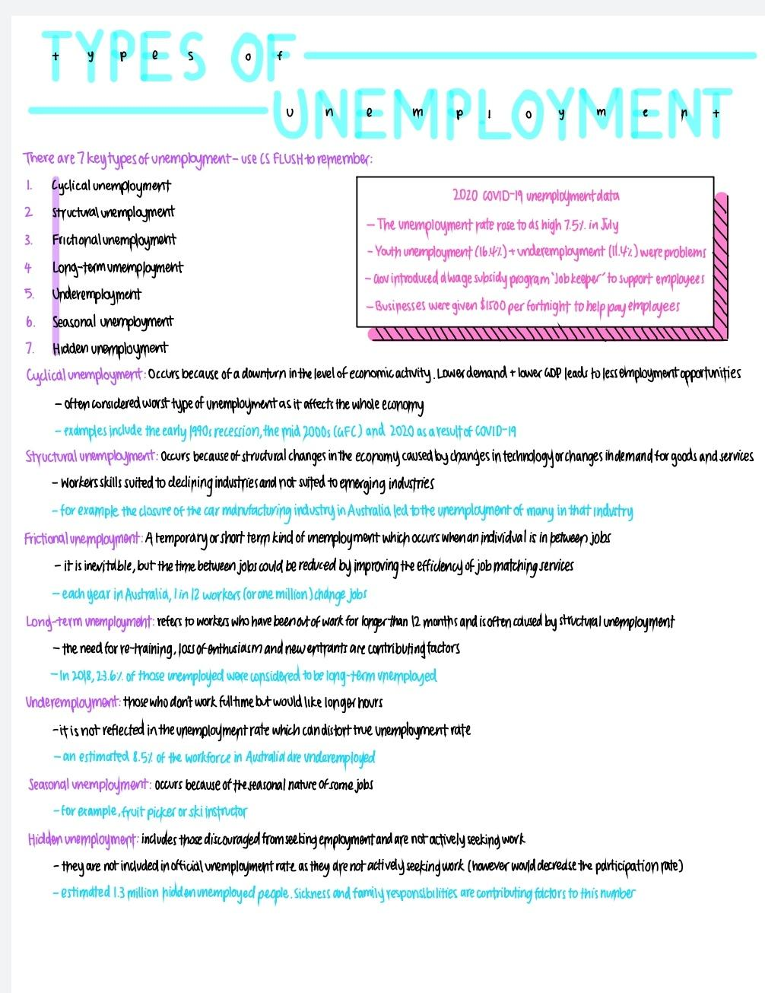
9. The iPad Student

Slide 50
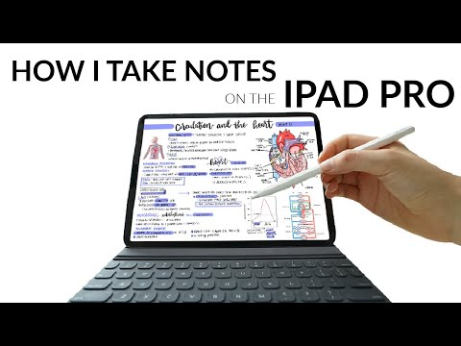

Slide 51
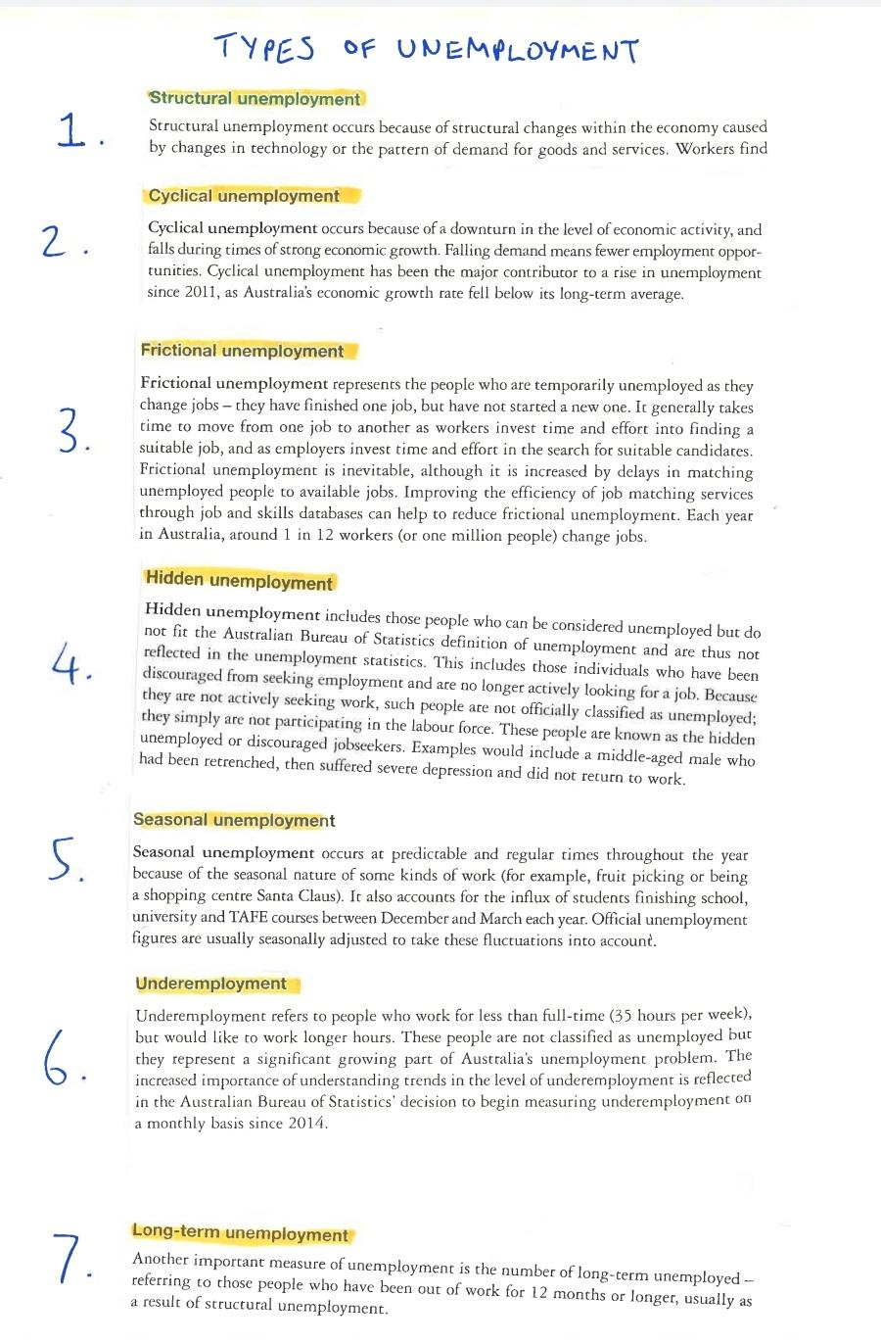
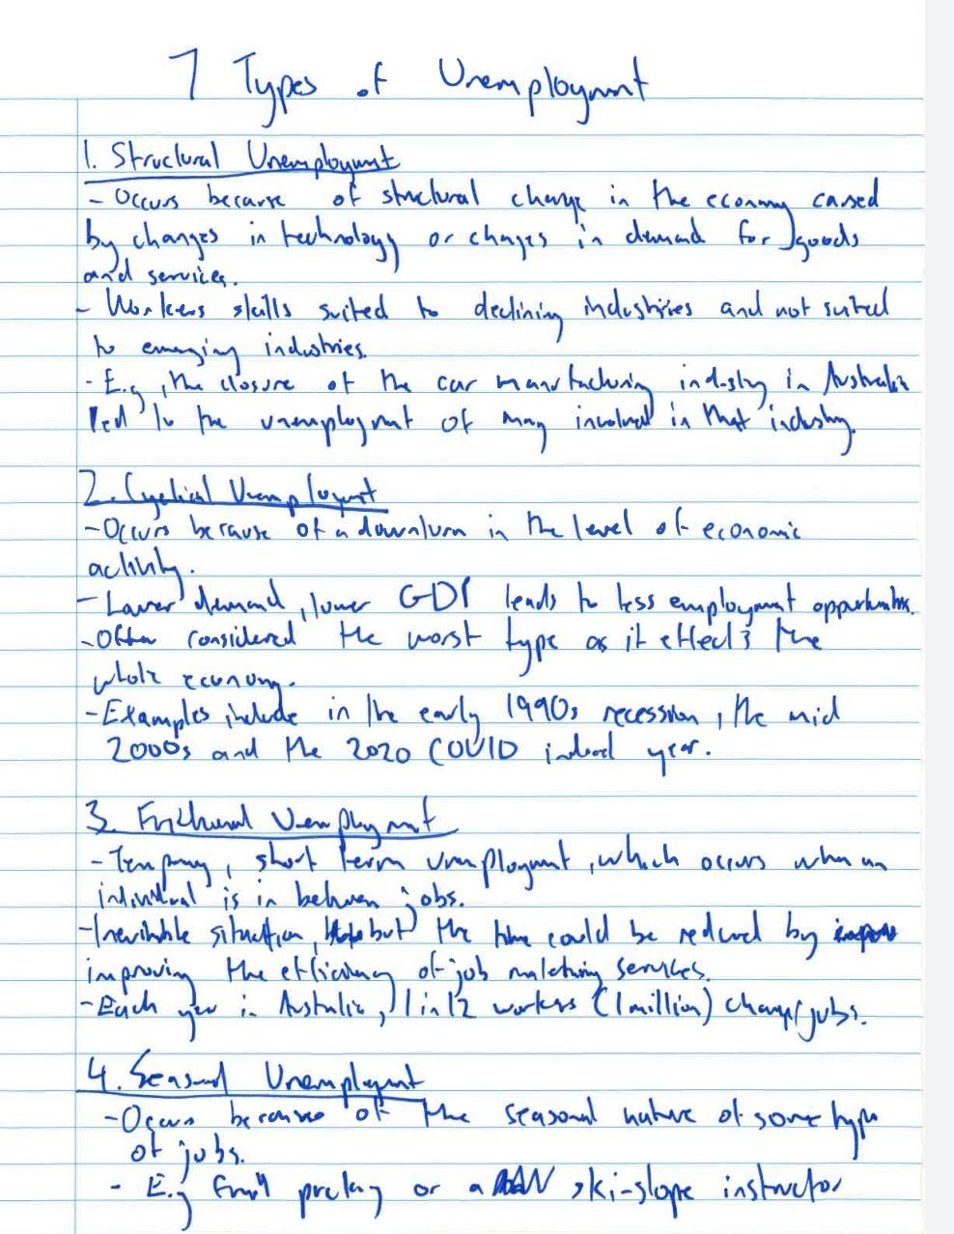
INEFECTIVE NOTES
COPY/PASTE
MESSY

Slide 52
Step 4: Storing your Study Notes
Creating effective notes is one thing, keeping them stored in one easy to reach, accessible place is another.
Remember the key is to be organised.

Slide 53
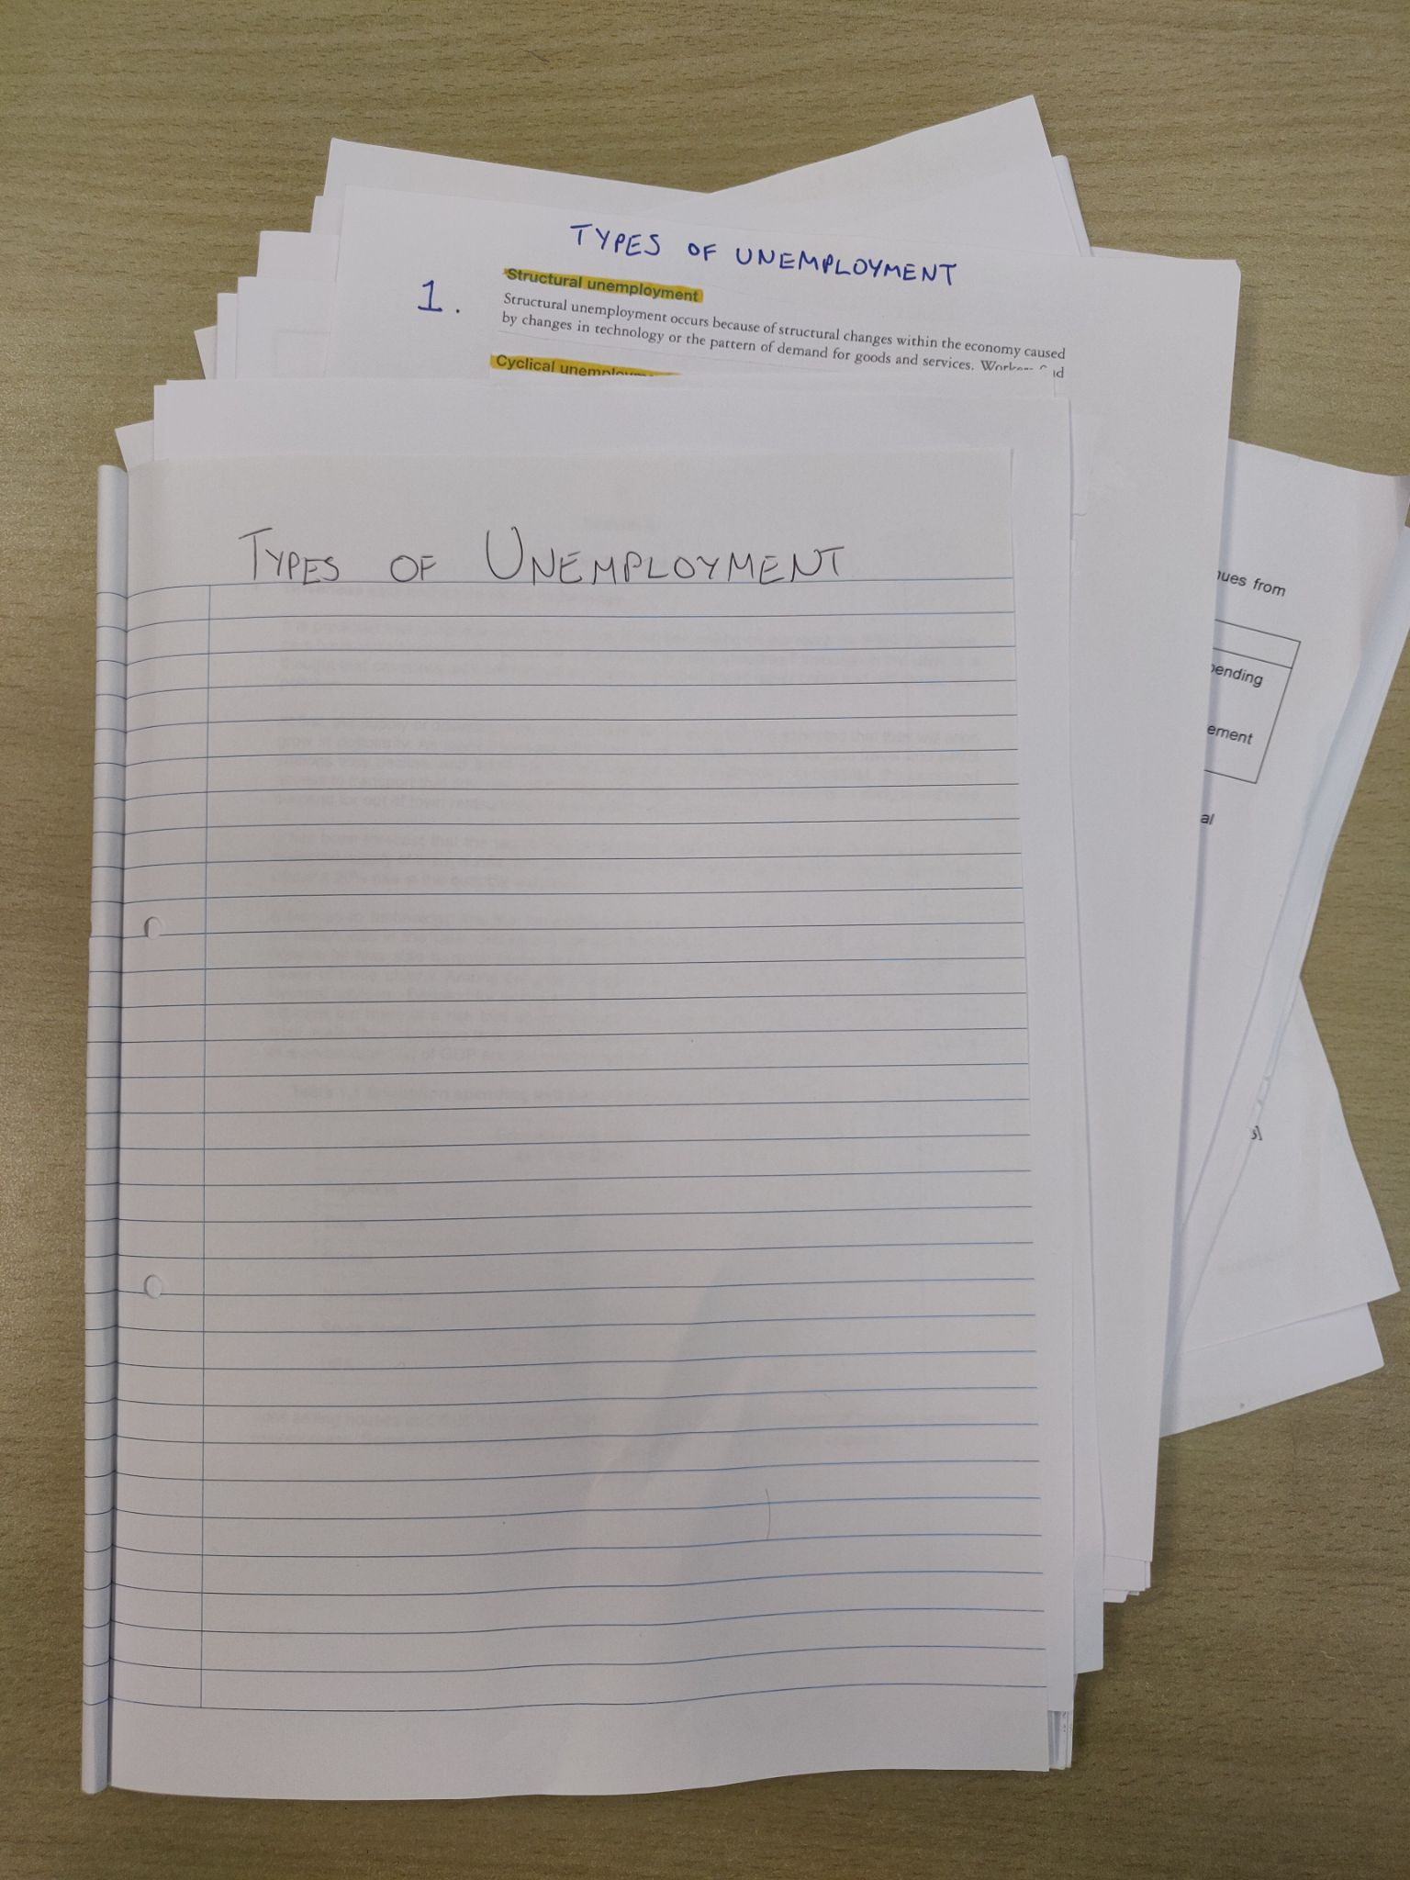
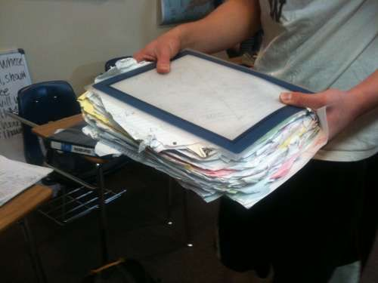
“What not to do”
DO NOT mix up your subjects in the one notebook or folder. Have a separate notebook, folder or exercise book for each subject.
DO NOT have loose notes lying in your folder, locker, bag or anywhere.. Keep them safe and organised.
DO NOT leave notes stored digitally, print them out (some exceptions to this, see upcoming slide)

Slide 54
This is how the most efficient and organised students store their notes.

Slide 55
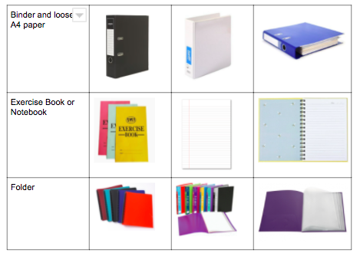
They use one of the following three items for storage of notes

Slide 56
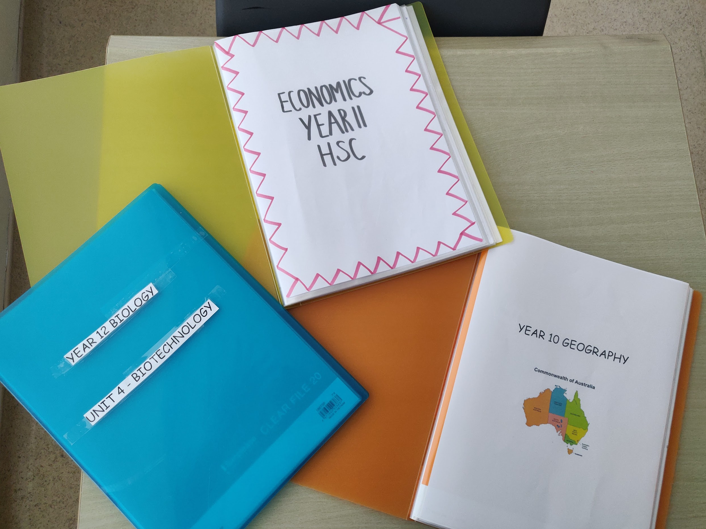
2. Separate notes for different subjects, even different units
Whatever storage system you decide, have a separate folder/binder/notebook for each subject. If you want to break it down further have a separate folder/binder/notebook for each unit/topic in each subject. Make sure these are labelled or have cover pages.

Slide 57
3. Include extra important documents
Some students add extra documents in their binder/folder/notebook:
The syllabus at the front
Any important handouts that adds value to your notes
Past tests and exams

Slide 58

4. Keep Folders/Notebooks/Binders in a convenient, reachable place
Preferably keep your notes somewhere where you know they will always be.
This will be usually somewhere safe on your study desk at home or in your locker. Something like these book holders below are great for storage.

Slide 59
What about the digital note-taking students?
The suggestion is if you have digital notes, print them off and slip them into a folder or binder.
Students are generally more efficient reviewing their notes when they have an actual hard copy.
With that being said, if you are still determined to keep your notes digitally stored, then great, it is your preference. Just make sure you are organised.
Saving everything under one big folder will just not work. Make sure you have:
- folders for each subject
- Within each subject you have folders for each unit/topic
This makes accessing particular sections/units easier.

Slide 60
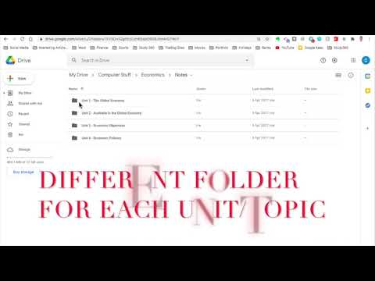

Slide 61
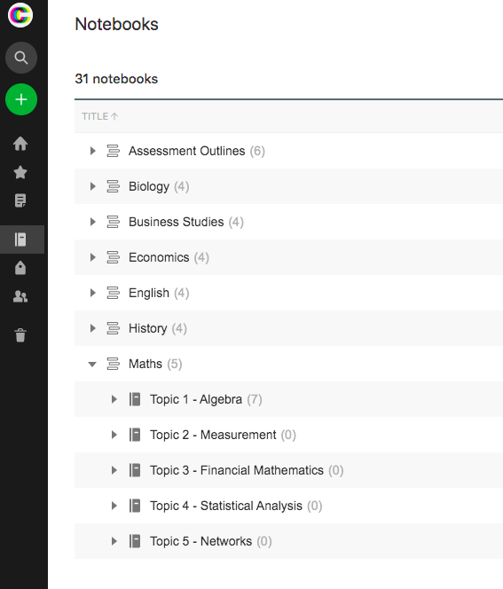
Apps like Evernote and Notion have a great storage system. You can create notebooks for each subject and topics within each notebook

Slide 62
Step 5: Figure out how to make the best use of your study notes
Congratulations, you have done your notes.
Now what?
Do they just sit on your desk until the night before an exam? No way. You need to be active.
You need to utilise this awesome resource you have created.

Slide 63

Review, review, review
Yes, it is true that the actual act of doing your notes helps the information sink in, but you need to review what you have created over a long period of time.
Read small portions on a weekly basis, do not cram before an exam or assessment. Read before you go to bed, read on the bus or train, read out aloud, read to your parents.

Slide 64
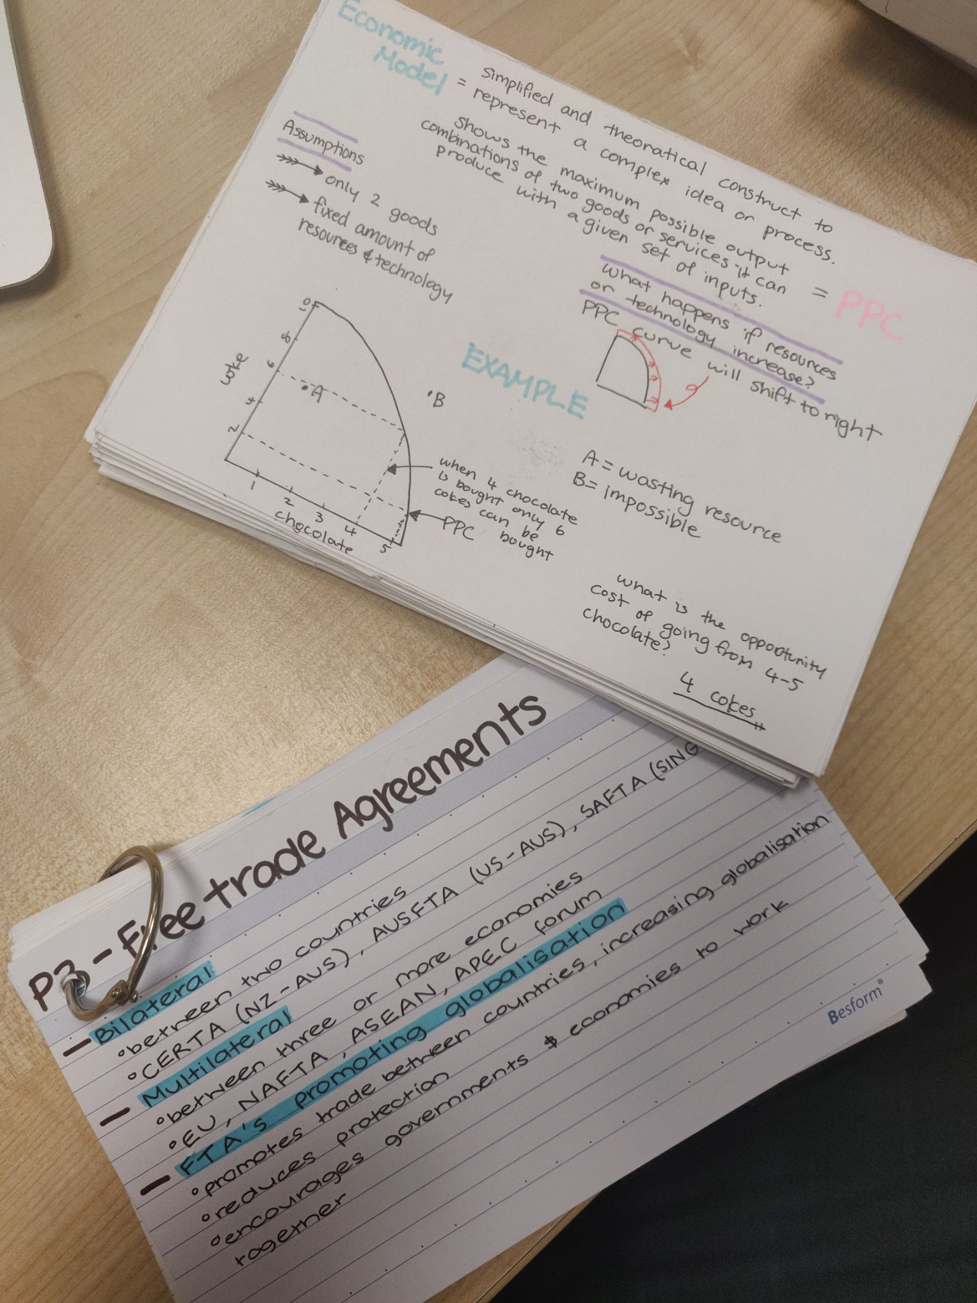
2. Rewrite
I have seen some students read over particular topics then rewrite as much as they can remember without looking at their notes.
Rewriting definitions, key factors, diagrams, anything they can remember.
Some transfer notes into even smaller, condensed summary pages or flash cards closer to exam time.

Slide 65

3. Practice past tests/exams using your notes for assistance
Memorising your notes is one thing, being able to use them to answer a question in an exam is a different thing altogether.
Use your notes to help you write these answers in practice papers. Once you are confident enough try the papers without your notes.

Slide 66

4. Rejig/add to your notes
You can always add/edit your notes. You may pick up some extra hot tips, or find a new example, or anything that you think might add value to your notes. The act of adding to your notes or rewording is powerful because it shows that you are understanding the important content that needs to be recalled.
5. Test a friend
Use your notes to quiz a friend in your class. If they don’t know the answer, tell them, teach them. They can do the same to you with their notes.

Slide 67
CONCLUSION
Effective note-taking is an important piece of the puzzle when it comes to nailing your exams and tests.
The most important takeaway from this unit is that note-taking is a skill. You need to experiment, and find out what suits you best. Everyone’s brain works in a different way.
Once you have found a style and layout that suits you, organise the time to prepare your notes on a weekly basis and put them to best use in the lead up to your tests and exams.
Good Luck

Slide 68

TASK 1
Using only the source below choose a layout from this presentation to create notes on the topic “How to make Chocolate”.
Choose a layout that suits you. It can be a digital or handwritten approach.
How to Make Chocolate

Slide 69

TASK 2
Below is a list of the most popular online note taking apps.
Click on and browse a few of the options. Most are free to sign up to. Have a play around and see if any appeal to you.
Evernote
Notion
One Note
Standard Notes
Google Keep
Typora
Ulysses (Apple only)
Apple Notes (Apple only)
Bear (Apple only)

