Slide 1
Motivation to study

Slide 2
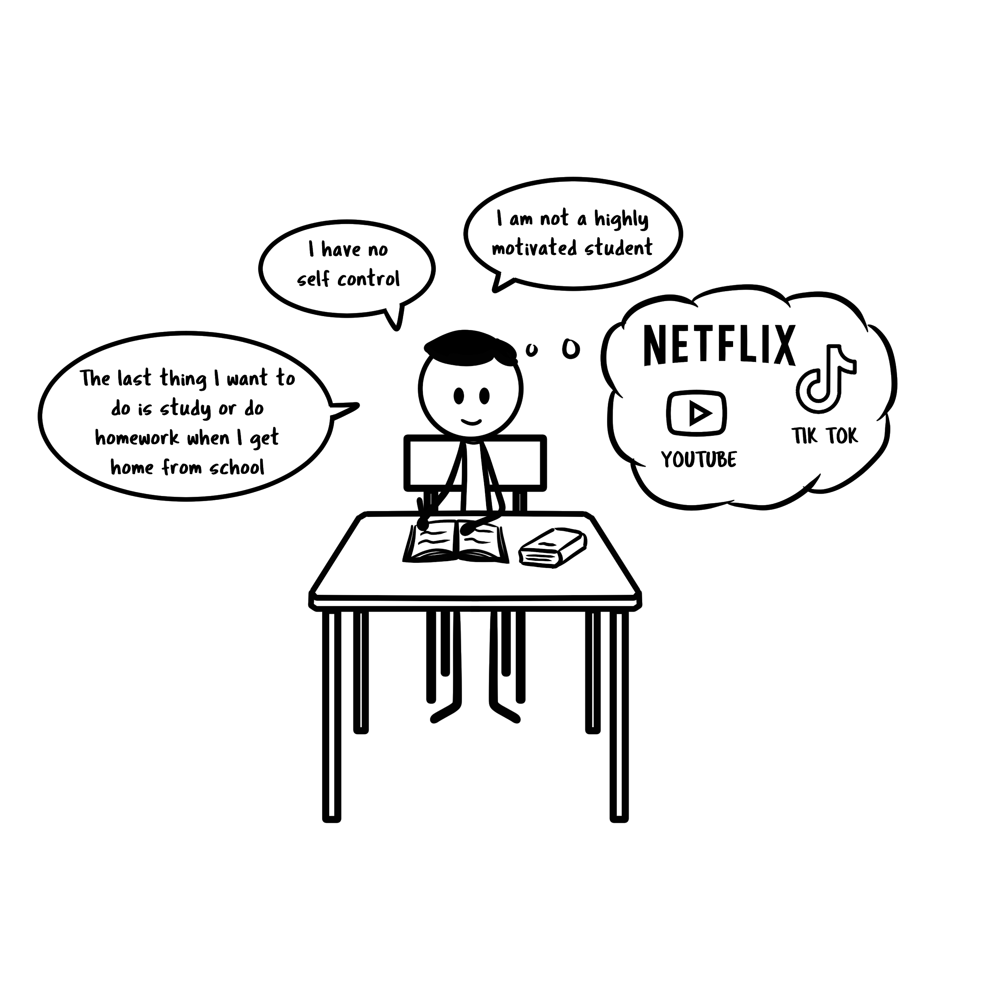

Slide 3
Who can relate to the previoius words and thoughts in the previous picture?

Slide 4
For many students, the motivation to study and complete homework is a never ending battle. Figuring out ways to motivate yourself can at times be impossible, and you become trapped down the rabbit hole of procrastination.
This unit looks at a number of ideas and strategies for students to become more motivated to study.

Slide 5
What is Motivation?
In simple terms, motivation is the enthusiasm of a student to complete a task or activity.
This enthusiasm if looking at a spectrum of motivation can range from 0 % to 100%.

Slide 6
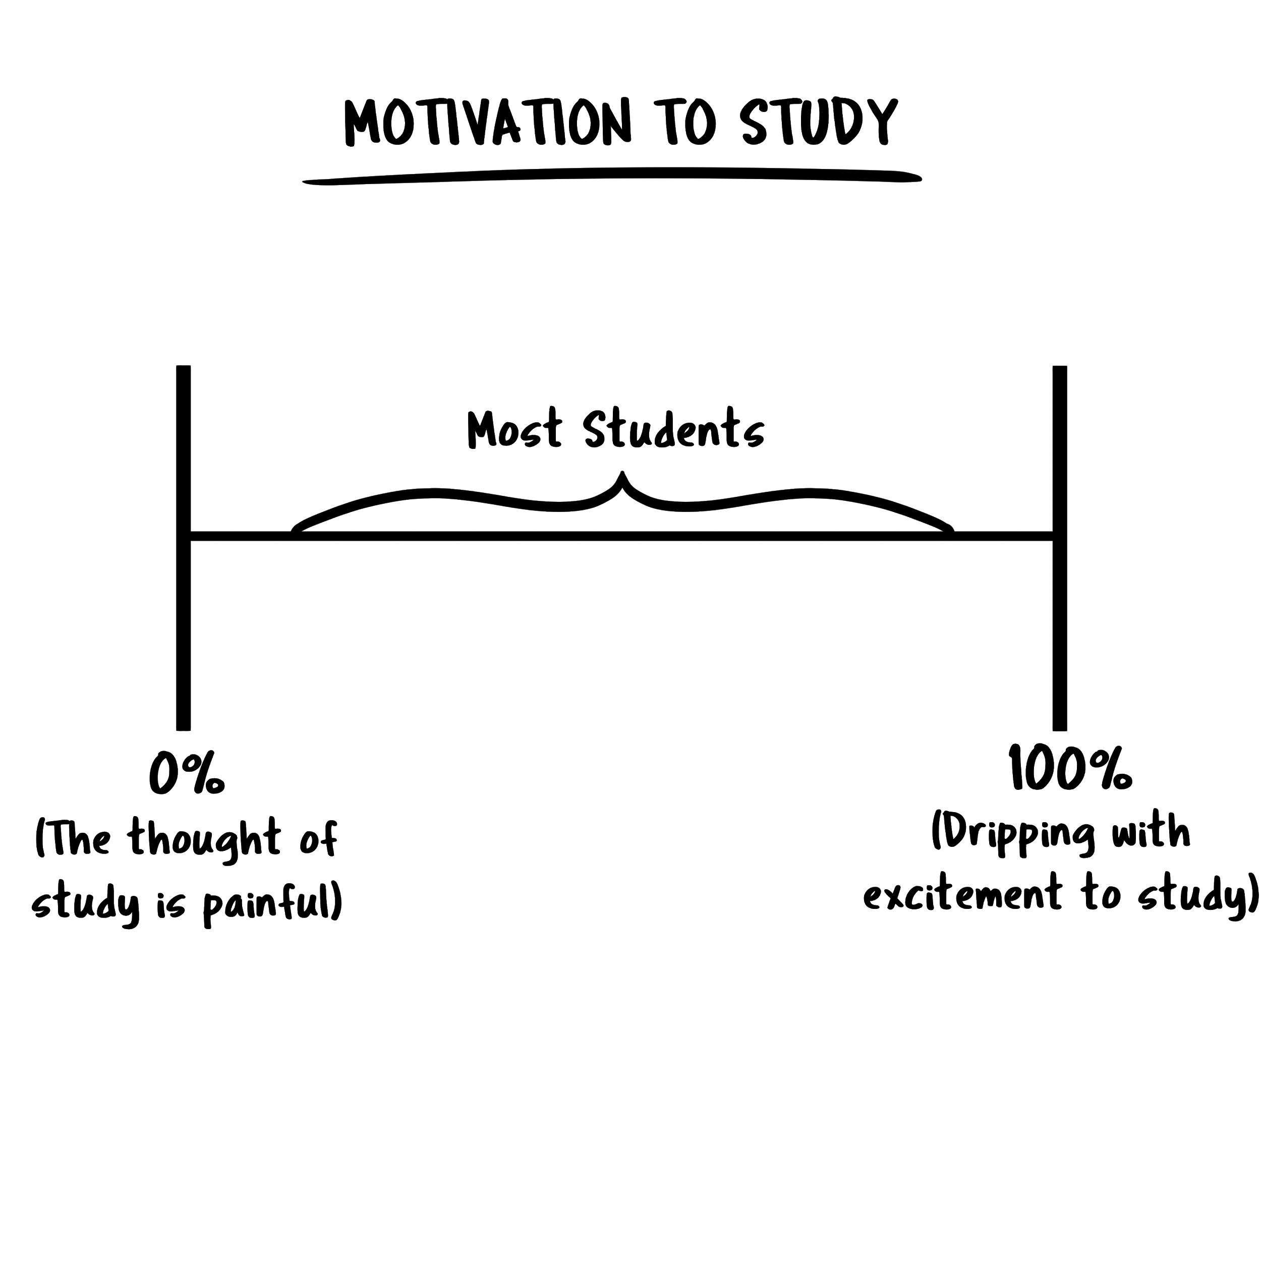

Slide 7

Common Mistake About Motivation
The most common mistake about motivation is that students assume it arrives before you sit down to study. Like motivation is some magical potion that gives you the urge to make a start.

Slide 8

James Clear, author of Atomic Habits, states that motivation is often the result of action, not the cause of it. Getting started, even in very small ways, is a form of active inspiration that naturally produces momentum.
In other words, this sounds simple, but the best way to find motivation is to MAKE A START. Don’t wait for motivation before you study. Instead get started and feel the motivation afterwards! MAKING A START is the key. Even if it's just one question or one paragraph, you will be surprised how quickly you can build momentum and keep going.

Slide 9
Some of you are probably thinking, ok, yes I understand this, but all this advice is not really helping me START my study or homework. How do I get off my phone or whatever it is I am wasting time with and just make a START.

Slide 10
The following are 18 tips and strategies that to help avoid procrastination and trigger that initial start to study or do homework.

Slide 11

CLEAR YOUR STUDY DESK AND DESKTOP
A clean study desk creates a clear mind and it helps kick start you into study mode.
The same applies for your computer desktop. The desktop should look tidy and not be a dumping ground for every file or document you save on your computer.

Slide 12

2. GET RID OF DISTRACTIONS
Turn the TV off
Put your phone into flight mode
Put your phone out of arm’s length, perhaps in another room
Turn off all notifications on your computer
Install a website blocker
Invest in a pair of noise cancelling earphones

Slide 13
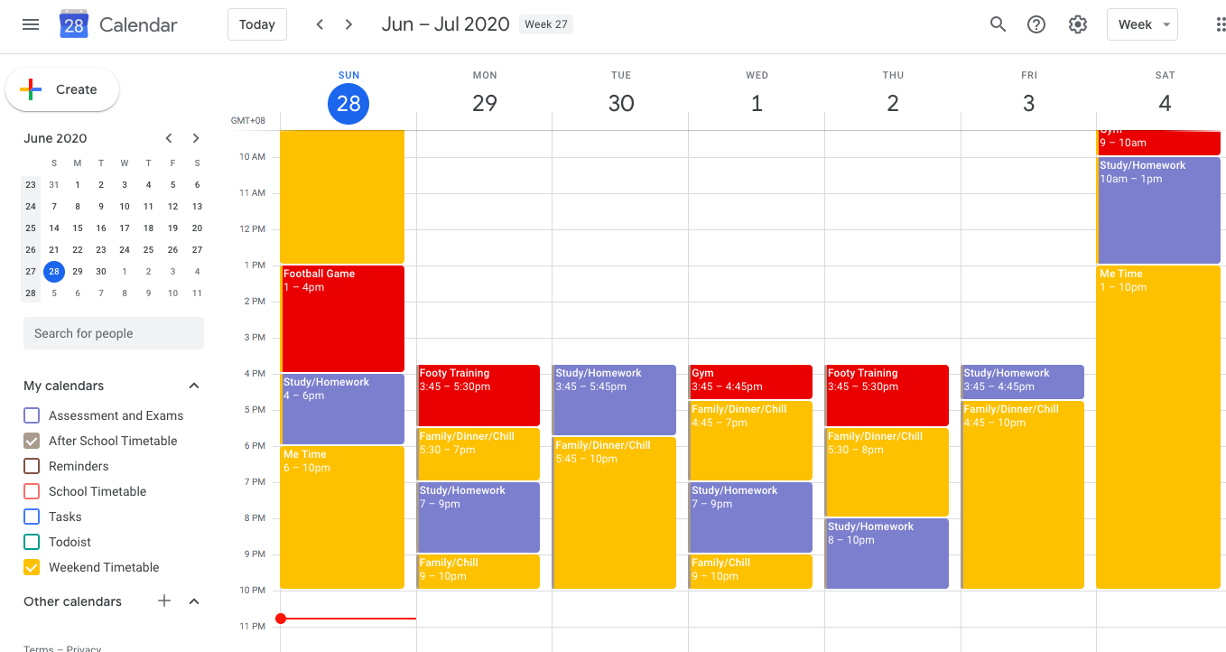
3. CREATE A STUDY/HOMEWORK SCHEDULE
Setting up a schedule can be a way to manage what you do during non-school hours and on the weekend. It also creates structure and makes it more likely that you will follow through with your study regardless of your motivation levels.
Don’t wait around for motivation, create a schedule and stick to it.

Slide 14
4. DEVELOP A STUDY RITUAL
A Study ritual is a little different from a study schedule, it’s more like a build up to a study session.
The ritual must occur every single time before you sit down and study. You want to get to a point where your mind is saying “this is what I do before I start a study session”. Eventually the ritual becomes part of the study process. You won’t need to find motivation, you just need to start the ritual.

Slide 15
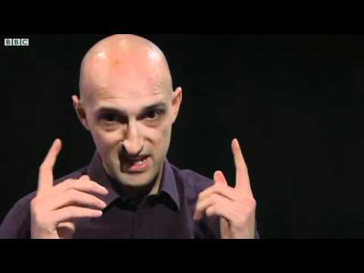
Some examples of study rituals might include:
Shower - Hot Milo - START
10 Minutes Social Media - Glass of Water - Snack - START
10 Minutes Meditation - Glass of Water - Snack - START
20 Minutes Netflix - Snack - START
Famous tennis player Rafael Nadal is famous for his rituals he performs every single game.

Slide 16
5. CREATE A TARGET GRADE OR GOAL FOR EACH SUBJECT WITH STEPS
Setting an end goal or target grade for subjects is a good way to motivate and give you something to strive for.
Goal Tracker
Goal Tracker Video

Slide 17
6. BREAK DOWN YOUR STUDY INTO SMALLER CHUNKS
Break up your tasks into smaller chunks.
If you have an assessment or something to study for, if possible, break it up into smaller parts and do them on different days.
Smaller tasks are less daunting and more manageable.

Slide 18

7. STUDY IN SHORT BURSTS
The Pomodoro Technique is a method of study in which you set a timer for a short burst of work, between 20-30 minutes. When the timer rings, you stop work and take a 5 minute break. Then repeat the process.
Working in short, intense bursts can increase your focus and concentration and the breaks give you the opportunity to pause, refresh and get ready to repeat another 20-30 minutes.

Slide 19
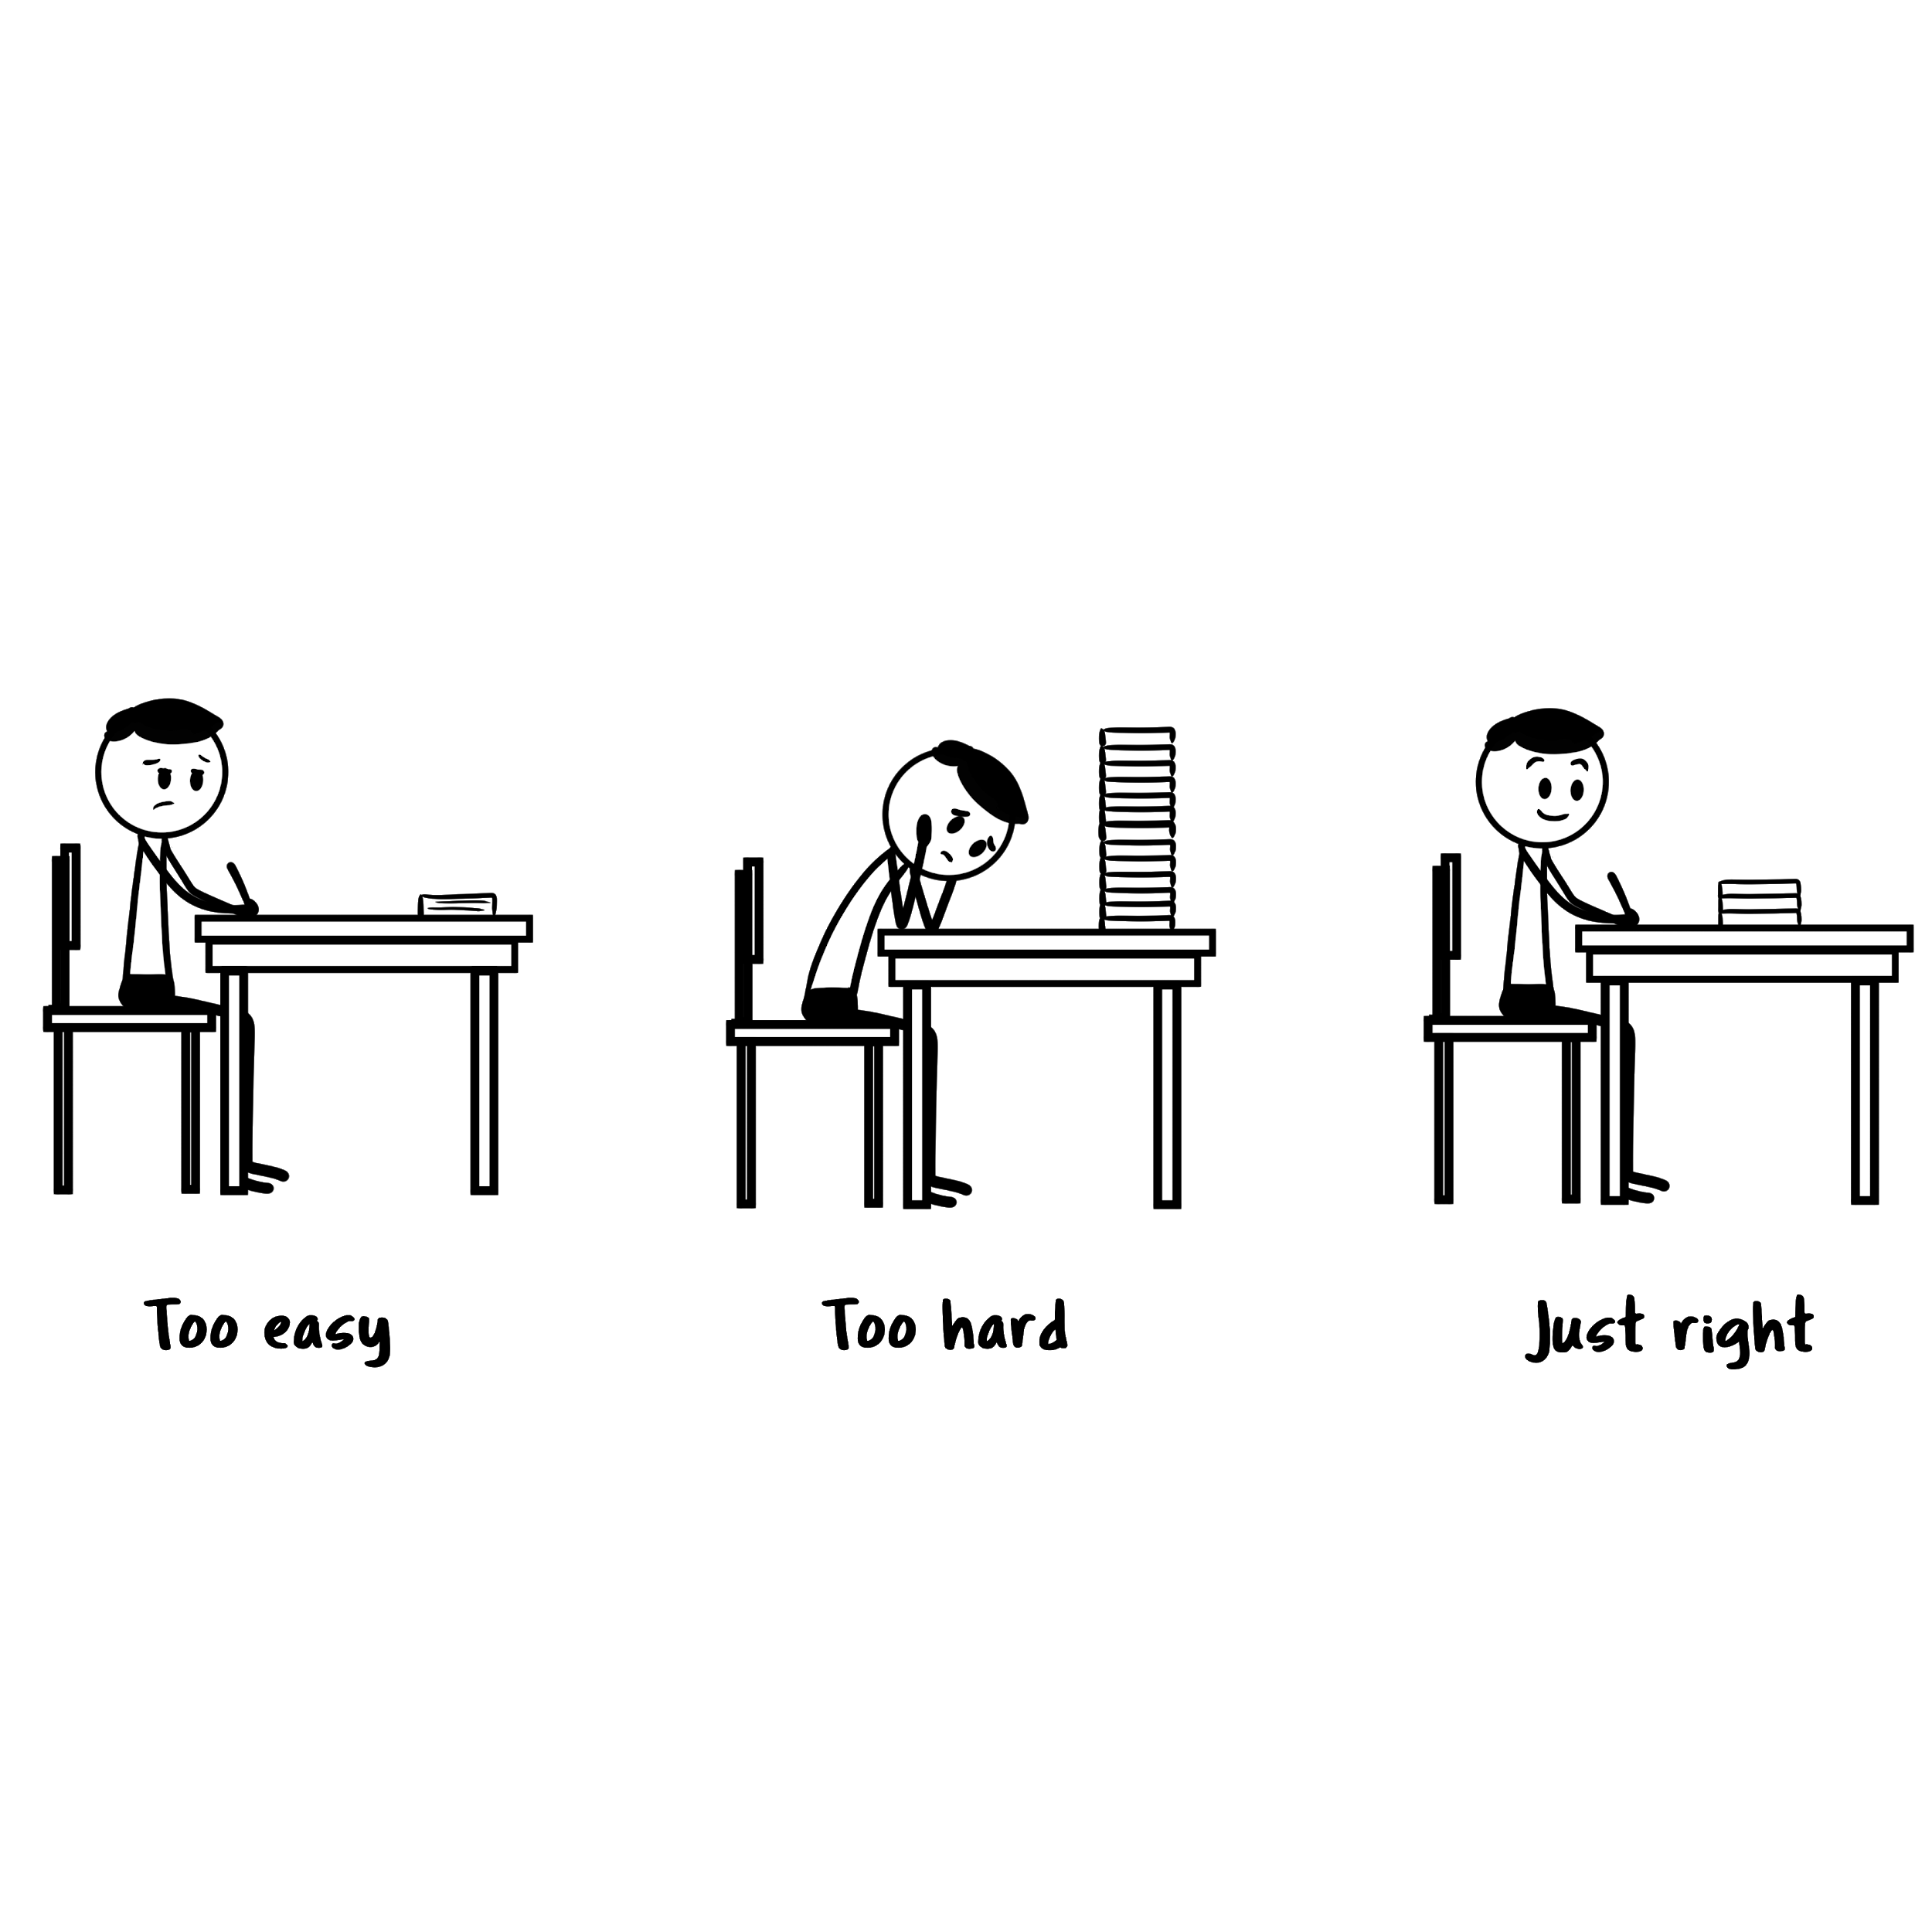
8. THE GOLDILOCKS RULE
Tasks that are challenging but not too complex are very motivating.
“humans experience peak motivation when working on tasks that are right on the edge of their current abilities. Not too hard. Not too easy. Just right.”
The easier tasks can perhaps be done in class or at school. The harder tasks perhaps also in class where you have peers and the teacher to assist you.

Slide 20

9. ACCOUNTABILITY BUDDY
This buddy is someone who helps you keep on track with your study goals and commitments.

Slide 21

10. STUDY IN A GROUP
Some students prefer to work alone, but working in a study group can be another way to make it easier to study and increase your levels of motivation.
Some of the advantages to working in a study group include:
The group gives everyone accountability to stay on track
Can be a lot more fun studying with your friends
Combine notes and share resources
Difficult concepts can be explained by others

Slide 22

1
11. FIGUROUT WHEN YOU STUDY BEST
Find out what time of the day you study best. You can use that information to alter your study schedule and take full advantage of what is the best fit for you and your motivation.

Slide 23

12. FUEL THE BODY
Nutrition, exercise and sleep are all vital to your health which is correlated to your energy and motivation levels.
Think about how motivated you feel when you have the flu? Or when you have a headache? Or when you are tired? There is limited motivation, there is no energy.
Get healthy, prime the body and watch your motivation to study increase.

Slide 24

13. CELEBRATE SUCCESS
Finish a study session with a reward, celebrate the success of grinding through a hard session.
This might be a binge of Netflix, or gaming, or social media. Whatever the reward, it reinforces the meaning behind all the hard work and makes it that little bit easier to start

Slide 25
14. HARNESS GRIT
Grit is the ability to persist in something you feel passionate about. It is about having direction and commitment. Gritty students stay committed to a task that may be difficult or boring.
The most successful students are not necessarily the most intelligent, they are the students who are gritty and consistently study and put hours of hard work into their education.

Slide 26

14. HARNESS GRIT
Psychologists suggest that there are certain things you can try to improve your grit.
Do subjects you are passionate about
Surround yourself with gritty people
Practice and more practice
Growth Mindset

Slide 27

15. EXERCISE THE BRAIN
Perhaps you can try some brain training apps to enhance your focus, consistency and motivation to study.
Your brain needs exercise just like any part of your body. You go to the gym to increase muscle mass or yoga to improve your flexibility
Some of the more popular brain training apps include:
Lumosity (free and paid versions)
Peak (free and paid versions)
Elevate (free and paid versions)

Slide 28
16. DO SUBJECTS YOU ARE PASSIONATE ABOUT
This one applies when you have the opportunity to choose your subjects.
When you actually enjoy the subject the motivation to study and do homework will be so much greater compared to a subject you dislike or see no relevance in.

Slide 29
17. DON’T EXPECT TO FEEL MOTIVATED ALL THE TIME
Stop expecting to feel motivated all the time. No one feels motivated all the time.
Instead of relying on motivation rely on your study habits, your rituals and schedule. Once these things become a habit you won’t always have to be fully motivated to start studying.

Slide 30
18. SHORT TERM MOTIVATION INJECTIONS
Motivational quotes and videos can be a little cheesy. And for the most part they are out of context and lose their original meaning and impact.
But they can give you that little push and some fuel to take action and start a study session.
Perhaps pick one or two of your favourite one liners and put them on your study desk or on your wall. At the least, they may be able to give you a little short term motivation injection.

Slide 31

18. SHORT TERM MOTIVATION INJECTIONS
Motivational Quotes 1
Motivational Quotes 2
Motivational Quotes 3
Motivational Videos 1
Motivational Videos 2
Motivation Quotes on Instagram 1
Motivation Quotes on Instagram 2

Slide 32
WHAT TO DO WHEN MOTIVATION IS FADING
Inevitably, your motivation during a study session will fade at some point. However if you really need to push on with an important assessment or task here a few suggestions to keep grinding through:
Get up, go outside, get some fresh air, and go for a 10 minute walk.
Get up and stretch for 3 minutes.
Remind yourself that pain is temporary. Yes, this study is hard and it is tiring, but it is temporary.
If study was easy, then everyone would get straight As. That moment when you are about to give up, remember that your life and success is determined by the thousand of decisions and choices you make on a daily basis. Make yourself proud, push through it.

Slide 33


PAST STUDENTS ADVICE ON MOTIVATION
Alicia scored a perfect 45 from 45 in the IB Diploma Program.
Adam received an ATAR of 95 after completing his NSW HSC Exams.

Slide 34
CONCLUSION
Motivation cannot be found in a magical potion and you won’t be motivated all the time.
The best way to find motivation is to make the initial start. Use the strategies mentioned to help you make that start. Not all of them will work for you, everyone is different. But if you can apply perhaps 5-10 of them it will help you make that initial start, build momentum and keep going.

Slide 35
TASK 1
Let students spend 20 minutes reading through Unit 1 on the website to get a further understanding on what drives motivation and the techniques use to help trigger a study session.
You can also print off the motivation checklist on the website to see which strategies you are and are not already using.

Slide 36
TASK 2
In groups of 3-4 pick the 5 best strategies that you think help in making that initial start to study or do homework.
Why did you pick these strategies?
Which ones are you already doing?
Which ones do you think will not work work for you?
Discuss your thoughts with the class.

Slide 37
TASK 3
Watch the Goal Tracker Video and make a copy of the Goal Tracker spreadsheet.
Have a go at filling out the spreadsheet. Don’t rush this, it will take time to do this properly.
Goal Tracker
Goal Tracker Video

Slide 38
TASK 4
Sign into Lumosity for a free brain training assessment and play some fun brain games.

Slide 39
TASK 5
Click on the following links to find 3 motivational quotes that you can display on your study desk for a short term study motivation injection.
Motivational Quotes 1
Motivational Quotes 2
Motivational Quotes 3
Motivation Quotes on Instagram 1
Motivation Quotes on Instagram 2

